Slide 1





Wemby’s Web: Hunting for
Memory Corruption in WebAssembly
Oussama Draissi, Tobias Cloosters, David Klein, Michael Rodler,
Marius Musch, Martin Johns, Lucas Davi
34th edition of the ACM SIGSOFT International Symposium on Software Testing and Analysis
Notes:
20 min + 4 min Q&A

Slide 2








WebAssembly (Wasm)
[Haas, et al., PLDI 2017]
http://CuteCats.com/
u8 decodeImage (ImageData v)
Compilation
decoded = decodeImage(imageData);
Instantiation
Wasm Module
func $decodeImage
Notes:
Developers can bring code from different programming languages into their web apps.
For instance, here we have the cutecats app.
Usually the developer would rewrite this app to javascript. however, the developer can now compile it to a webassembly module.
This module can then be directly embedded into the web app. Here we see that the image decoding function is now directly accessible from the javascript,
As if it is a normal javascript function.
Webassembly finds ist way in more and more popular and prominent web applications

Slide 3

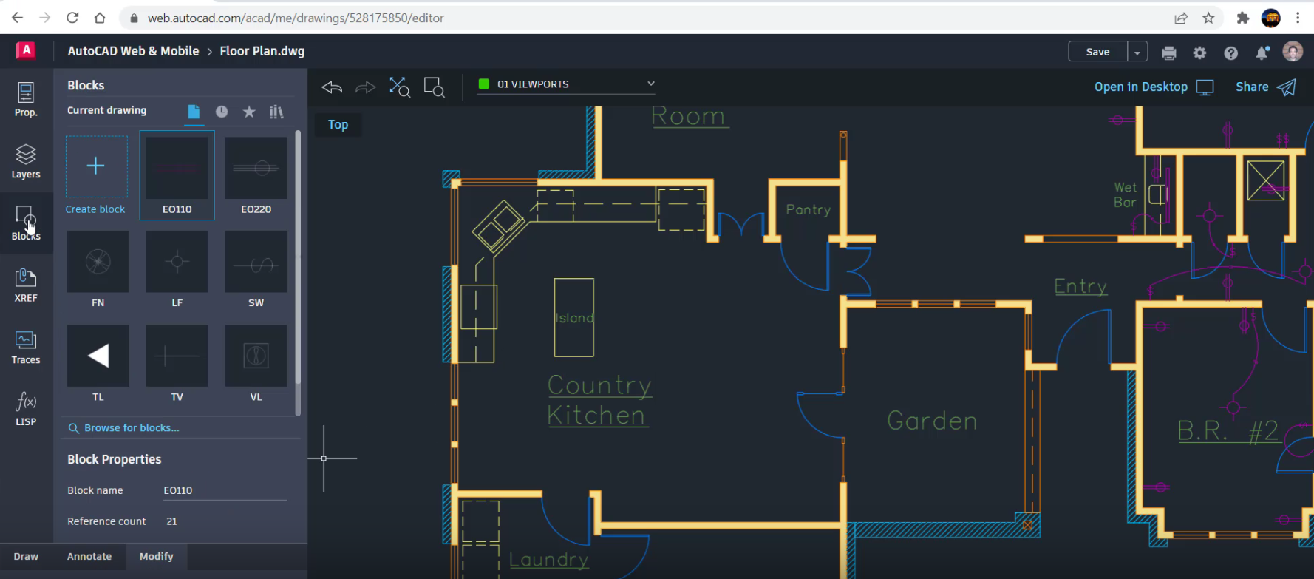
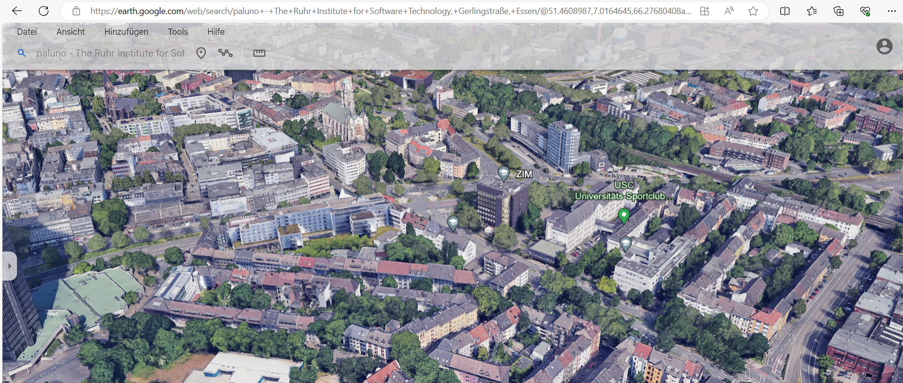





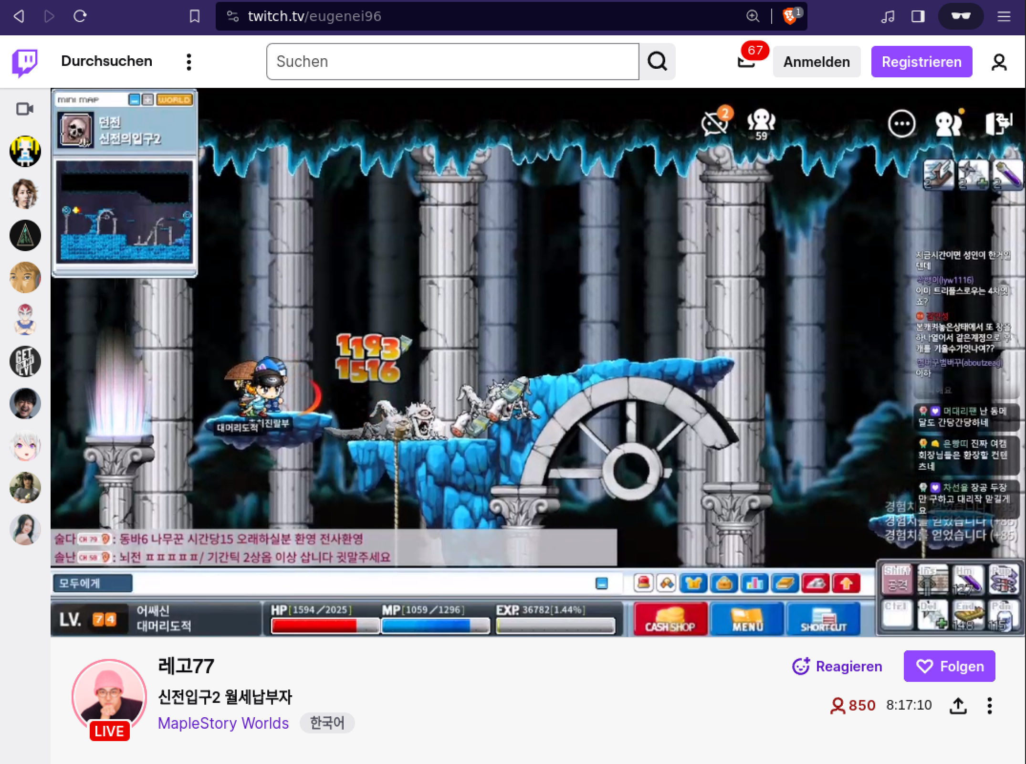


Applications using Wasm
5% of every Google Chrome page load, instantiates a Wasm module!
"Dieses Foto" von Unbekannter Autor ist lizenziert gemäß CC BY-NC
Notes:
- AutoCAD
- Google Earth
- Photoshop
- Twitch / Amazon IVS
- Zoom

Slide 4
Security By Design
Many common security mechanisms are not needed
Data Execution Prevention
[Solar Designer, ‘97], [Microsoft, ‘06]
  Code Immutability
Stack Canaries/Guard Pages
[Cowan, et al., USENIX Sec ‘98]
  Software Fault Isolation
  [Wahbe, et al., SOSP ‘93], [Yedidia, et al., ASPLOS ’24]
Randomization
[PaX Team, ‘01], [Ahmed, et al., USENIX Sec ‘23]
  Control Flow Integrity
  [Abadi, et al., Tissec 2005], [Houy, et al., TOSEM ‘24]
Notes:
Wasm is designed with an emphasizes on security, and many commonly deployed security mechanisms are not necessary.
By design, the Wasm module cannot arbitrarily access critical data from the host, such as the return addresses. are by design inaccessible (stack canaries unnecessary)
Preventing arbitrary system and memory access (e.g., the return address)
Fully mutable and zero-initialized upon allocation, thus any valid in-bounds access is valid

Slide 5








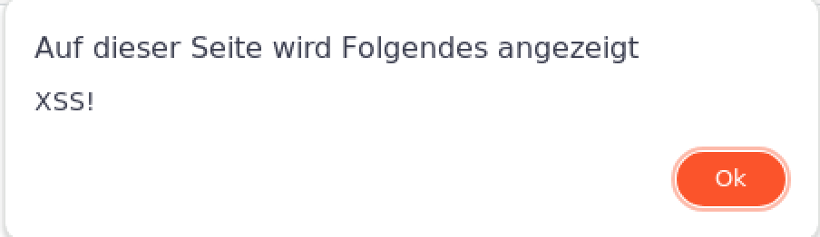

From a Memory Error to Cross-site Scripting (XSS)
[Mcfadden, et al., Blackhat 2018] & [Lehmann, et al., USENIX Security 2020]
External input data
img_tag is attacker controlled → XSS!
Memory
http://CuteCats.com/
imageData = getRandomImage();
decodeImage(imageData);
alert(„XSS!“)
tag
AAAAAAAA
AAAAAAAA
AAAAAAAA
AAAAAAAA
...
image
string tag = "<img src='data:image/png;";
void decodeImage(ImageData image) {
//...
JS.writeToDom(tag, img);
}
AAAA
Contains a buffer overflow!
Notes:
Now we return to the Cutecats app, which the developer has extended with an image registry.
Users can now share their picture with other users. These users visit the website and then a random image of this image registry is displayed. We see, that the webapp enables the Wasm module to directly write to the DOM.
This design is very popular and used in a lot of WebApps, such as Twitch and Zoom, where the data comes from a server.
However, the attacker has now detected a buffer overflow in the Wasm module.
The attacker can now place the malicious code to abuse this bug into the image registry.
An user would now visit this website, and the payload is now injected into the victims Wasm module.
Because there is no randomization or guard pages, the attacker can reliably overwrite the data that is written into the DOM with malicious code.
Here, the img_tag can be written with arbitrary JS code, which give the attacker Remote Code Execution.

Slide 6
Related Work
WAFL
[Haßler et al., ROOTS’22]
FUZZM
[Lehmann et al., 2022]
Wasmati
[Brito et al., Computer and Security ‘22]
Wasabi
[Lehmann et al., ASPLOS ‘19]
TaintAssembly
[Fu et al., 2018]
Not suitable to detect bugs in Wasm-powered websites
Ignores the interaction between Wasm and the host
Wasm is stateful
Require manual analysis to use
Notes:
So, we know that Wasm is popular but is vulnerable to memory corruption.
There are different approaches to detect bugs.
All approaches fail to detect bugs because they only focus on the Wasm module itself but ignore the interaction with the host.
How is attacker-controlled data consumed by the module? How much does the application trust the data coming from Wasm?
Approaches also do not scale, for instance, the Zoom Wasm module has 18k functions and no definite entry point.
The existing approaches do not know, which of the 18k functions have to be analyzed. If one of these fuzzers finds a bug in one of these functions,
But these functions are never called, it is a false positive.

Slide 7
How to automatically detect bugs at scale?
Combining taint tracking
with fuzzing!

Slide 8




Wemby Architecture
External input data
http://CuteCats.com/
Binary Address
Sanitizer
Generate structured input
1
3
Trace tainted data
Emulate JS
from record
A
2
Snapshot Wasm memory at function calls
C
B
D
E
H
G
4
Fuzzer
Notes:
Fully automated reverse-engineering and fuzzing framework for Wasm-powered websites
Analyzes an attacker’s interaction interface with the target Wasm module through taint-tracking
Reveals what functions an attacker and what data is controllable
Embeds the analysis into a coverage-guided snapshot fuzzer
Instruments Wasm modules to detect memory corruption vulnerabilities
Incorporates the state (i.e., the memory) of a Wasm function call to increase fuzzing coverage
Automatically generates test-driver code

Slide 9
What is the real-world impact of this threat model?
Using Wemby on 37,000 domains

Slide 10

New Attack Vectors
Source | #Domains
XMLHttpRequest.response | 5118
WebSocket | 4971
location.href | 2401
location.pathname | 194
sessionStorage.getItem | 41
location.search | 41
location.hash | 20
External input data
Only <2% of the dataflows are sanitized!
29,000 websites

Slide 11
Implicit Trust, Explicit Danger
Sink | Vulnerability | #Domains
Function.ctor | XSS | 2286
a.href | XSS | 1341
fetch.url | Request Hijacking | 1054
innerHTML | XSS | 842
eval | XSS | 643
open(url) | Request Hijacking | 497
sessionStorage | Stored XSS | 345
document.cookie | Stored XSS | 80
string tag = "<img src='data:image/png;";
void decodeImage(ImageData image) {
//...
JS.writeToDom(tag, img);
}
Insecure memory management,
no sanitization,
easy exploitation!
4,000 websites

Slide 12
Prevalance of a new
Threat Model
We detected 2782 domains vulnerable to this threat model

Slide 13
Memory Corruption in the Wild
Fuzzed 76 Wasm websites
Zoom stack-based buffer overflow → Arbitrary write
Memory corruption to XSS on different websites
All detected memory errors are browser reproducible
Notes:
We demonstrated Wasm memory corruption escalating to XSS on a website
Wemby identified unsanitized WebSocket data and critical linear memory offsets, enabling overwrites of strings (i.e., Date.now() to create timestamps) directly consumed by eval

Slide 14
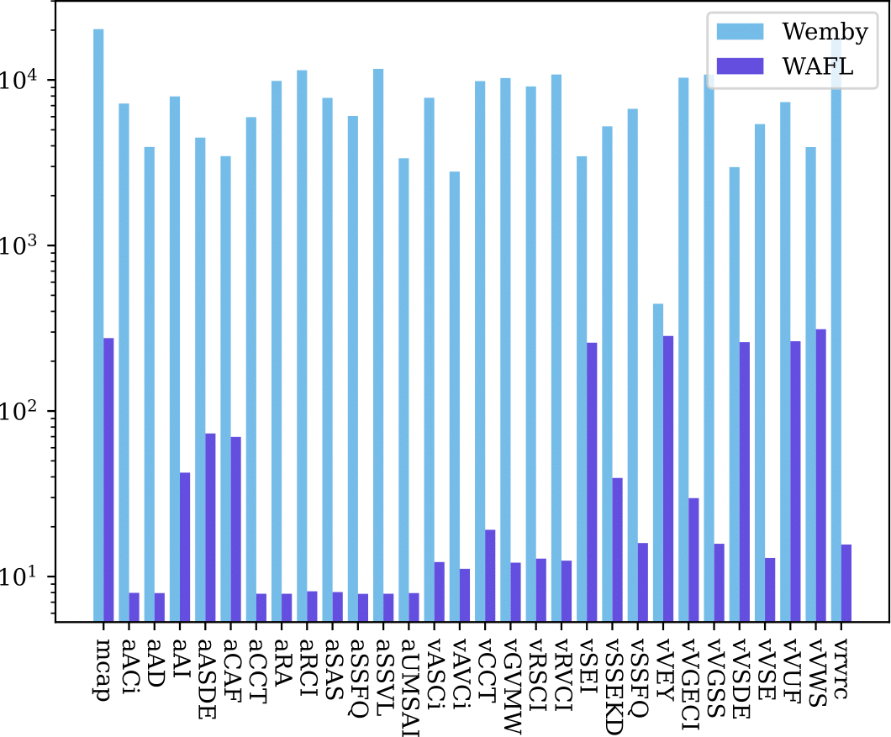
Quantitative Evaluation
Benchmarking against WAFL and Fuzzm
Slashes false positives by six-fold
Snapshots boost code coverage by 46% on average
Outperforms WAFL by three orders of magnitude in execution speed

Slide 15
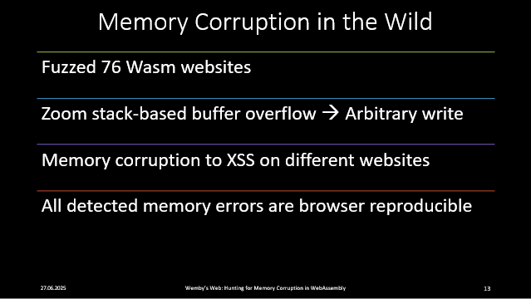

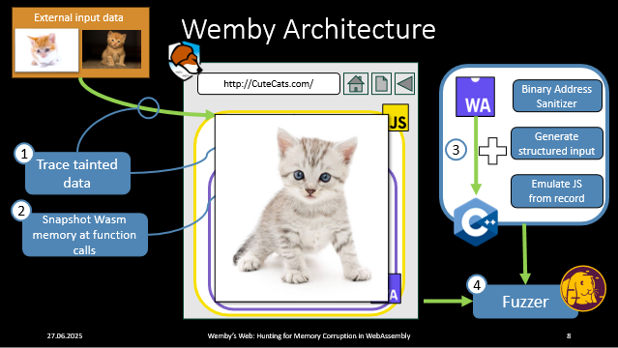
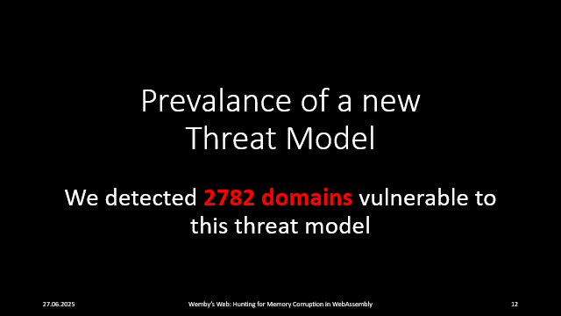
Bringing fine-grained
memory segmentation back to the Wasm memory!

