Slide 1



Bento
a software MMU for WebAssembly
Fine-Grained Memory Isolation for COTS WebAssembly Binaries
Oussama Draissi Lucas Davi
paluno - University of Duisburg-Essen
The Web Conference 2026 . Dubai, UAE . July 2026

Slide 2

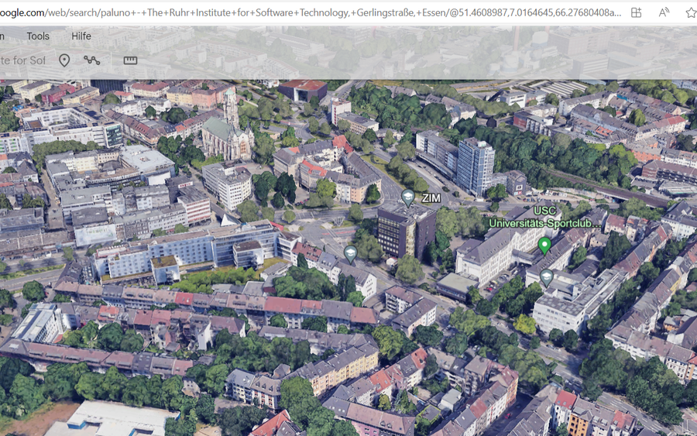


WebAssembly Powers the Web
[Haas et al., PLDI 2017]
C / C++ / Rust
WebAssembly module
Browser + JavaScript
Twitch
Google Maps
Photoshop
Zoom
5%+
of all Chrome page loads instantiate a Wasm module

Slide 3
Security by Design
Wasm's design removes classic memory exploits. One gap remains.
SOUND BY DESIGN
THE GAP
Code is immutable, so no code injection
overflow
Stack
Heap
Data
Structured control flow gives CFI for free
- Linear memory has no internal isolation
Sandboxed execution is SFI by default
- Data-only corruption still crosses regions
DEP, stack canaries and ASLR are unneeded
Control-flow defenses do not stop data-only attacks inside one flat memory.

Slide 4


From a Memory Error to XSS
CuteCats.com decodes a third-party image in the visitor’s browser. One crafted file is enough.
Attacker
crafts a malicious .png
3rd-party image registry
hosts and serves the file
Visitor’s browser
fetches & decodes (libpng → Wasm)
ATTACKER-CONTROLLED
ONE LINEAR MEMORY
no boundaries between regions
https://CuteCats.com
STACK
image buffer
AAAA AAAA AAAA
This site says
XSS!
HEAP
✗ no boundary
...
DATA
tag = "<img ...>"
OK
alert("XSS!")
.png from a 3rd-party registry
looks like a cute cat
the page renders corrupted data → XSS
A bug in one region rewrites trusted data in another.
No control-flow hijack, just a full cross-site scripting attack.

Slide 5
This Threat Is Everywhere
Measured in our Wemby paper · Draissi et al., ISSTA 2025
OUR PRIOR WORK
37,000
domains analyzed
2,782
domains vulnerable
< 2%
dataflows sanitized
A prevalent, real-world threat model.

Slide 6
Related Work
No prior defense protects deployed Wasm.
Need source, runtime, or hardware
Fragile, need debug symbols
PKUWA
[Lei et al., CCS'23]
RLBox
[Narayan et al., USENIX Sec'20]
Fuzzm
[Lehmann et al., '21]
WBSan
[Wu et al., WWW'25]
MS-Wasm
[Michael et al., POPL'23]
WaVe
[Johnson et al., S&P'23]
detect bugs after the fact, never prevent them
The open gap: proactive hardening for stripped COTS Wasm, on the standard web.

Slide 7
THE SOLUTION
Every prior defense needs more than a stripped binary has.
Bento
Give each region of a Wasm binary its own isolated memory.
binary-only
no source, no symbols
automatic
no developer effort
near-zero overhead
no deployment penalty

Slide 8
Today: One Shared Memory
a normal load into the one shared memory
i32.load $image
STACK
HEAP
DATA
Stack, heap and data share one linear memory.

Slide 9
Bento: Isolated Memories
the same load, now bound to a separate memory
i32.load @Heap $image
Wasm multi-memory feature · standard since Wasm 3.0
@Heap is just a memory index. Zero new instructions.
STACK
memory 1
HEAP
memory 2
DATA
memory 0
Each region is its own memory instance, isolated by the runtime.
The index is baked into immutable code, so a bug cannot redirect it.

Slide 10
How Bento Works
1 Lift to BentoIR
Recover a value-flow graph from the stripped binary.
2 Classify pointers
Tag every access as stack, heap, or data.
3 Rewrite memory
Send each access to its own memory instance.
Bento-Coarse stack · heap · data
Bento-Fine per-function frame
Fully automatic, binary to binary. The output is a standard Wasm module.

Slide 11
Bento Stops the Exploit
The same malicious image hits CuteCats.com. Libpng CVE-2018-14550.
WITHOUT BENTO
WITH BENTO
image buffer
HTML tag
image buffer
HTML tag safe
alert("XSS!") runs in CuteCats
CuteCats loads.
No XSS.
The overflow stays in the buffer's own memory. The HTML tag is untouched.

Slide 12
Evaluation
We harden and differentially test every binary, across three optimization levels.
THE CORPUS
WHAT WE FOUND
52
WABench + real-world apps
300
csmith programs
3
real-world CVEs
100%
identical memory traces
every access matches the unmodified baseline
DOMAINS scientific computing · cryptography · image processing · NLP · databases · networking
× 3 optimization levels -O0 · -O2 · -O3
100%
hardened automatically
no debug symbols, no manual steps — even custom allocators (libpng) detected
1,065
unique stripped binaries
Differential testing across 1,065 stripped binaries confirms Bento is semantically sound.

Slide 13
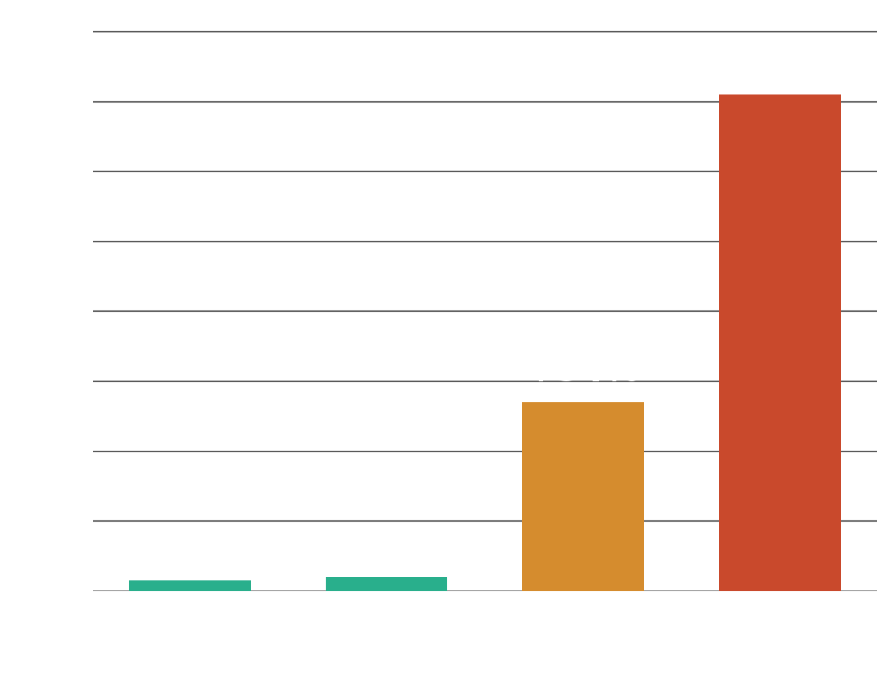
Near-Zero Overhead
Zero instructions added
1.00× fuel, no computational cost
Runs on stripped COTS
where WBSan and ASan fail
Architectural hardening: 3 to 4% runtime, ~1% startup and memory, automatic on stripped COTS.

Slide 14
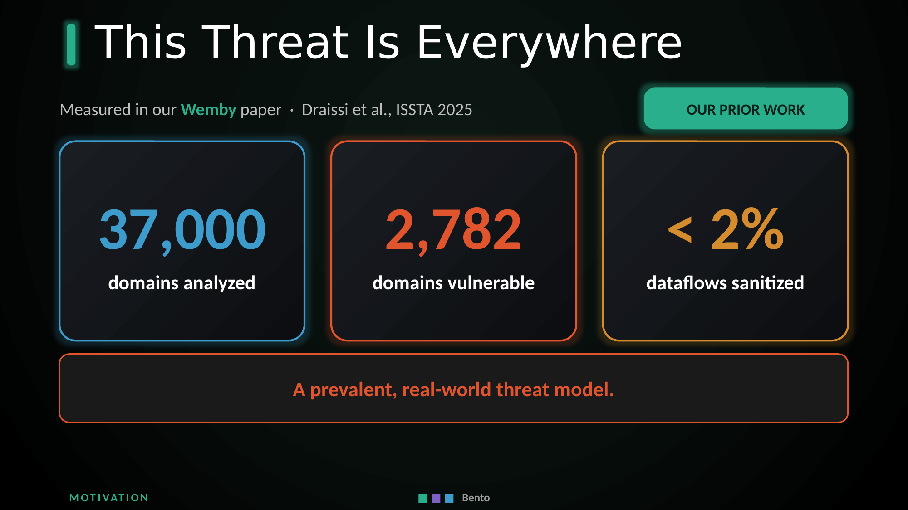
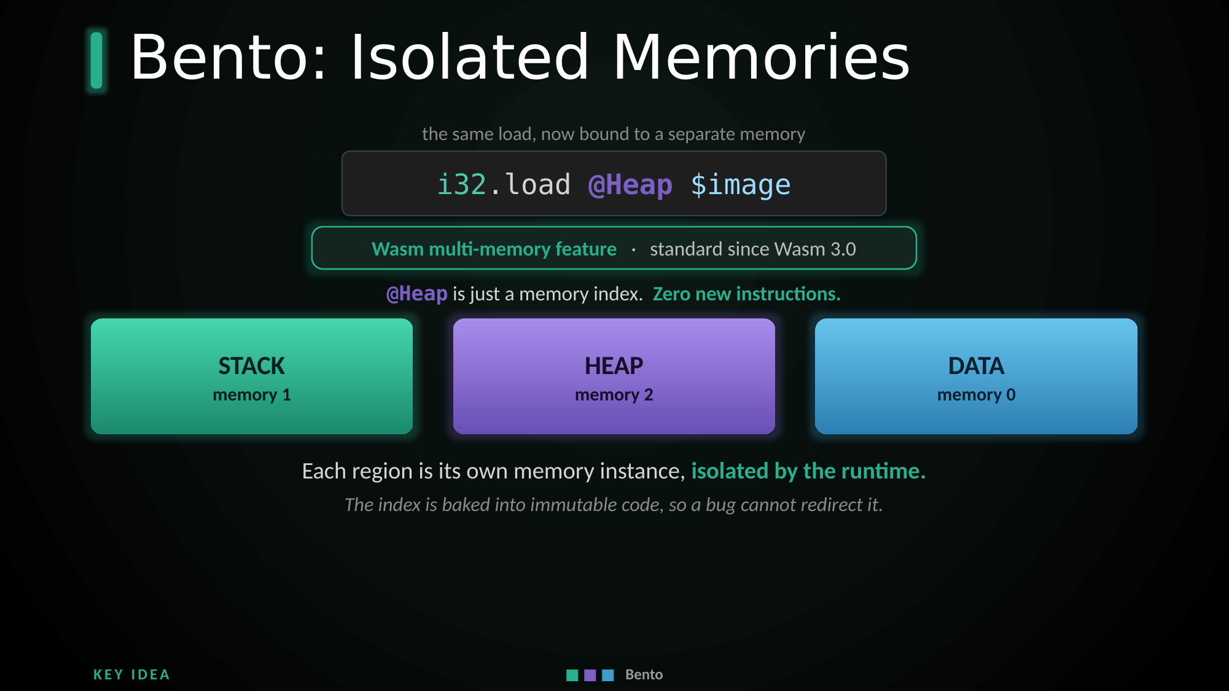
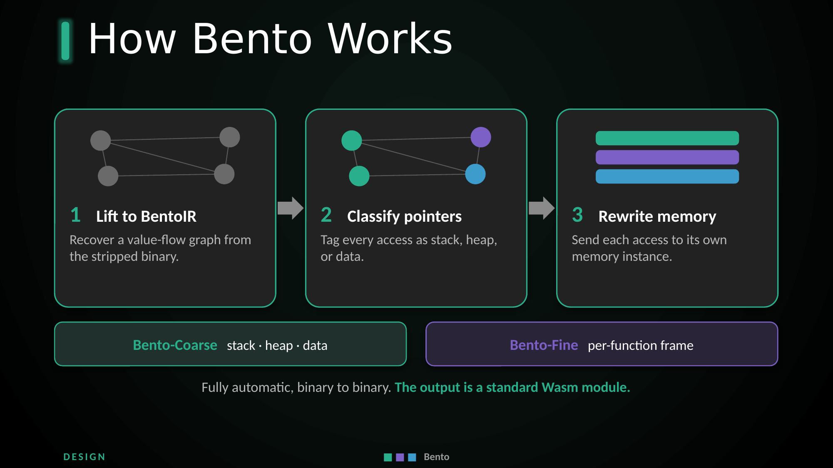
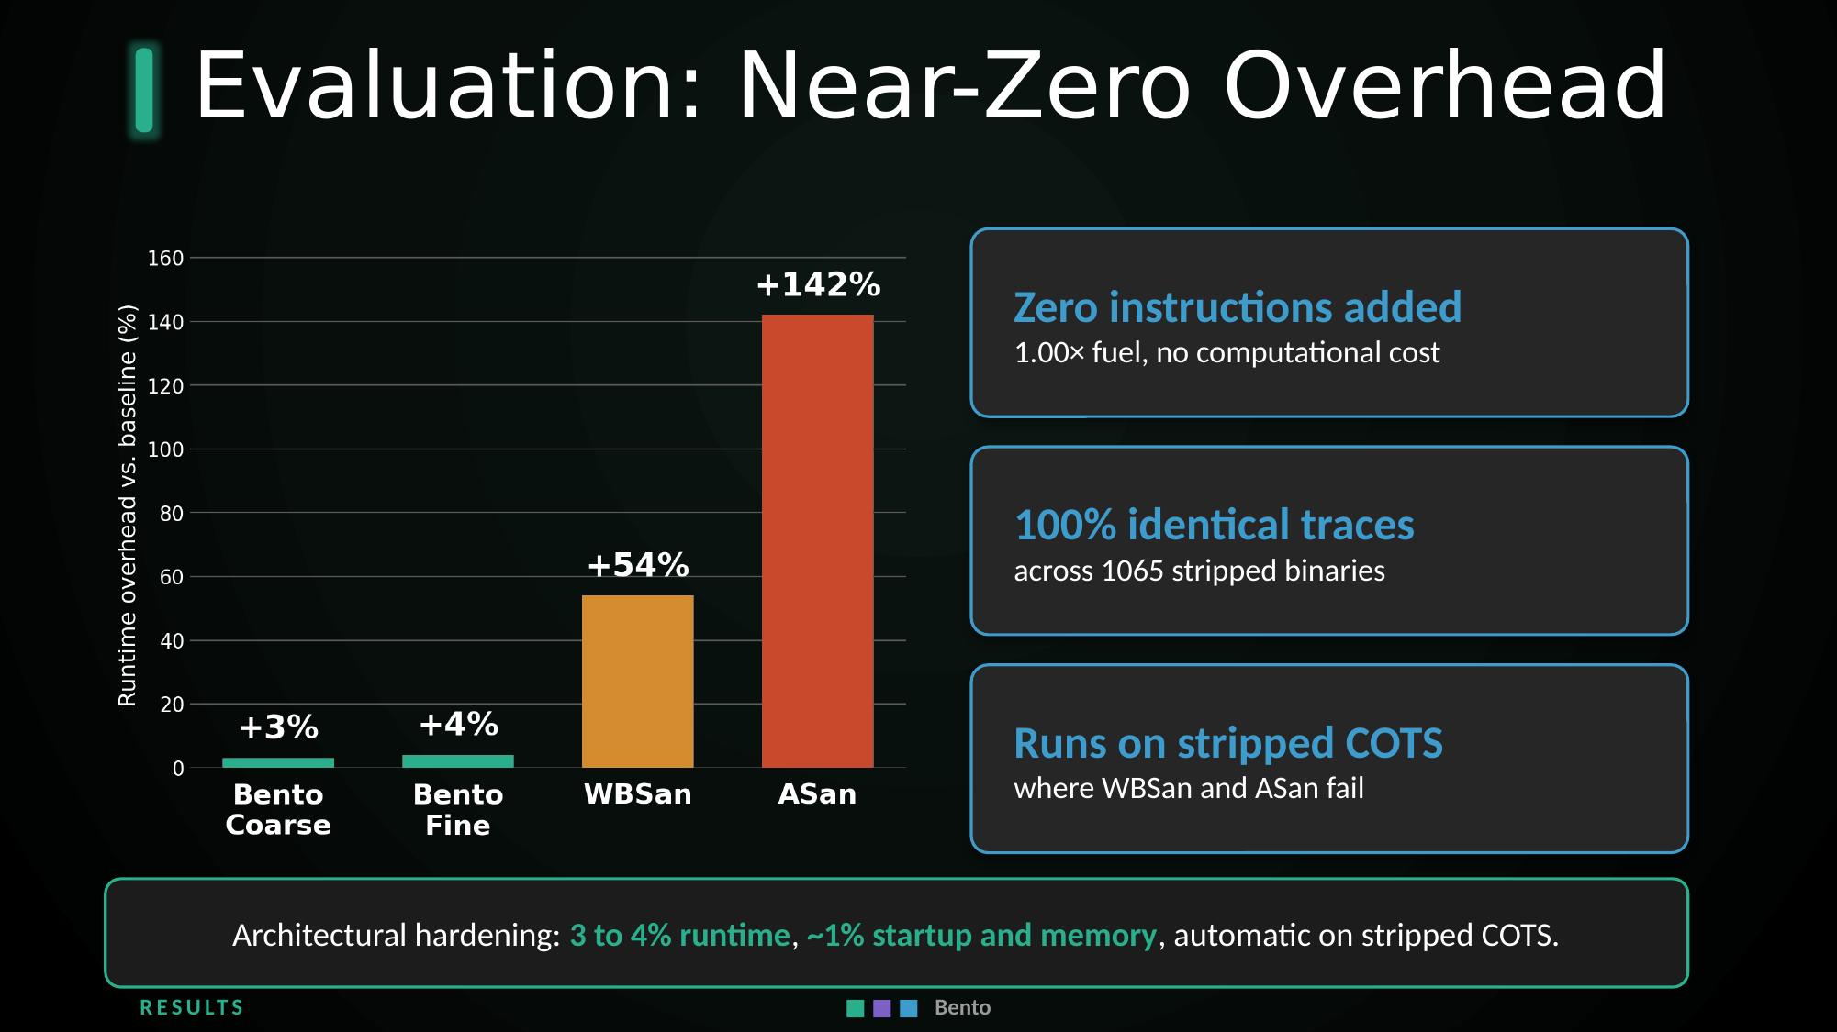
Bento at a Glance
The threat
The idea
How it works
The results

Slide 15

Thank You
Questions and collaboration are very welcome
@
EMAIL
oussama.draissi@uni-due.de
in
LINKEDIN
linkedin.com/in/oussama-draissi
scan to visit 0drai.xyz
WEBSITE
0drai.xyz
Bento · Fine-Grained Memory Isolation for COTS WebAssembly

